Slide 1
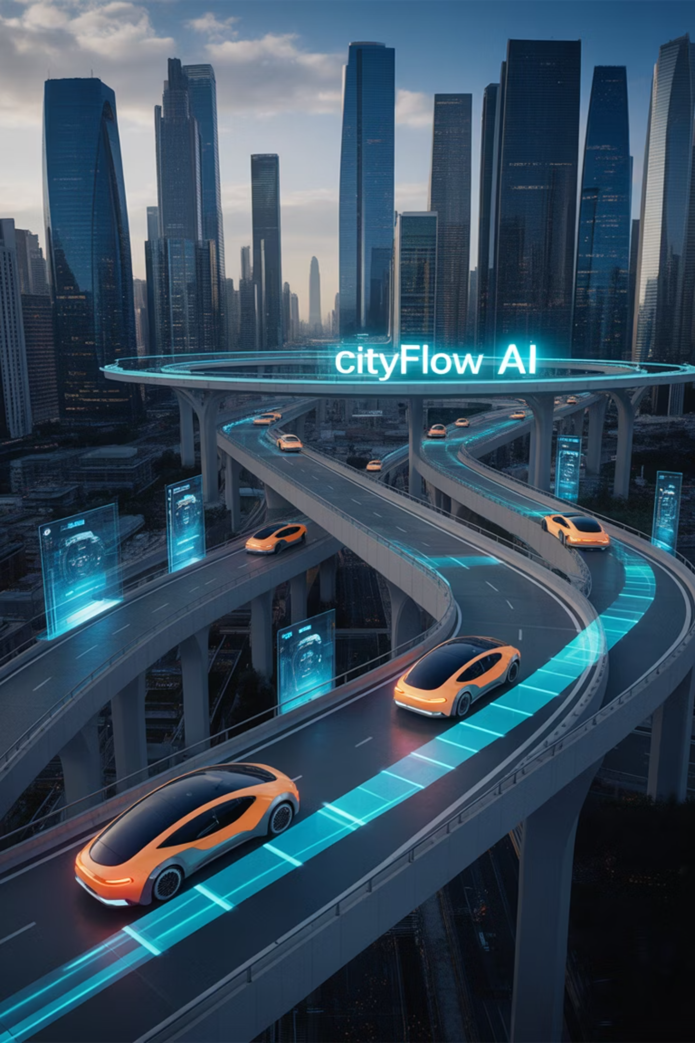
AI in Smart Cities and Transportation
June 23, 2025
by Michael Garcia, Hshim Sayed Hoosini, Miguel Mora

Slide 2
Domain Overview & Importance
Smart cities use technology to improve urban life and efficiency.
Transportation is a key pillar of city infrastructure and daily life.
Cities face congestion, pollution, and safety challenges.
Urbanization increases pressure on transport systems.
AI can optimize traffic, safety, and sustainability.
Better systems mean improved mobility and quality of life.

Slide 3
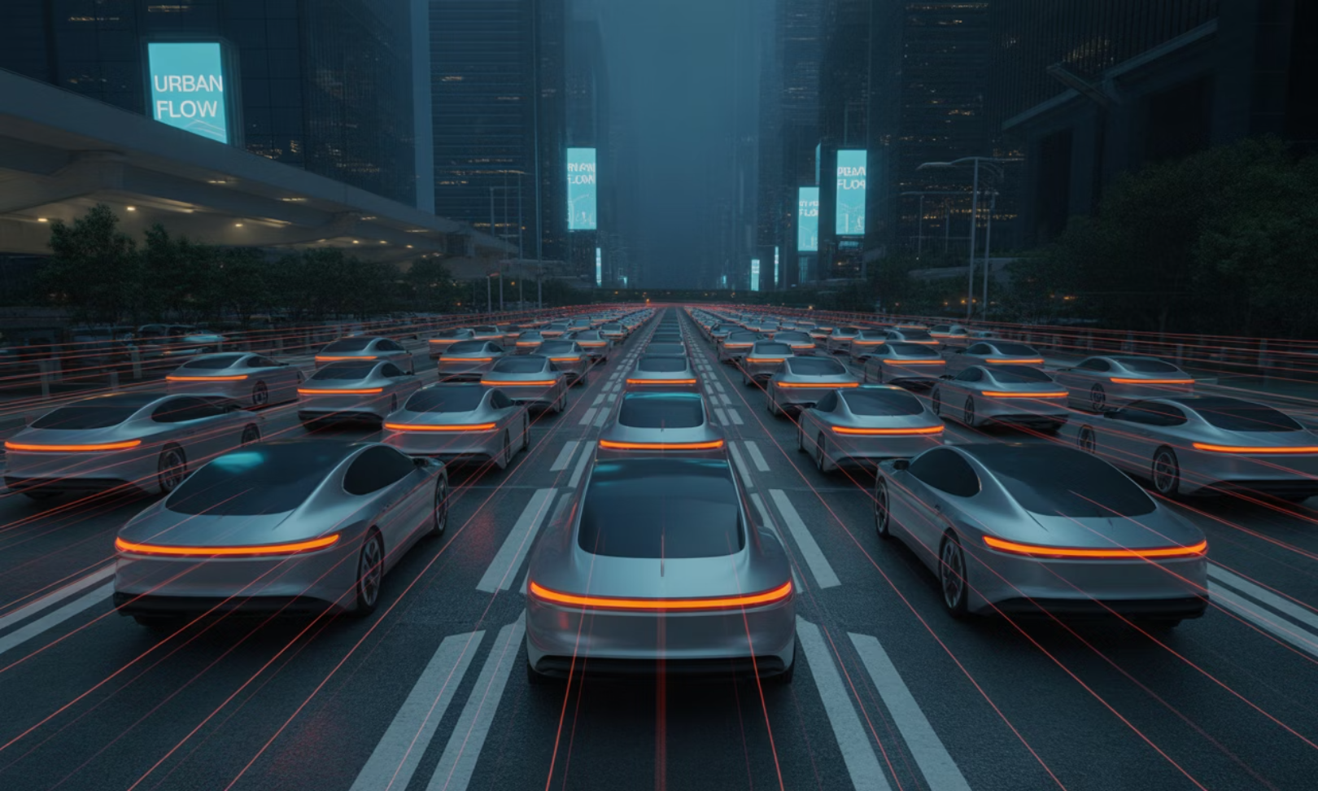
AI Use Case Motivation
Traffic congestion leads to lost time and fuel.
Public transport suffers from inefficiency and poor planning.
Traditional traffic systems lack adaptability.
Road safety remains a global concern.
AI enables predictive, real-time traffic management.
Example: Google DeepMind's AI reduced traffic signal wait times in the UK by up to 30%.

Slide 4






AI Techniques Used
Machine Learning (ML)
Computer Vision
Predicts traffic flow and demand.
Detects accidents, violations, and pedestrian activity.
Reinforcement Learning (RL)
Natural Language Processing (NLP)
Adjusts traffic lights based on conditions.
Powers voice assistants for transit info.
Data Fusion
Edge AI
Combines sensors, GPS, and cameras for insights.
Runs traffic AI locally for speed and privacy.

Slide 5
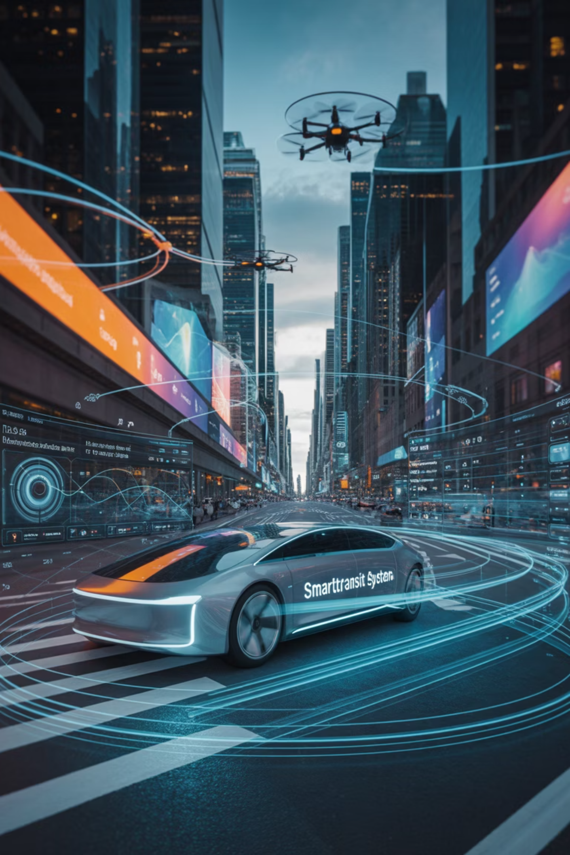
Key Applications
SINGAPORE Smart City
E-government & Data Integration
Singapore's Smart Nation Platform foster secure Inter- agency data sharing rules rather than centralizing all data. The government has started E- government services since 1980s, now using the Information and communication Technology (ICT) for broad public administration.
Smart Energy
Singapore's aims to be energy-efficient and eco- friendly. With smart sensors embedded inside, household appliance such as lights can be automatically turn off when no one is home, or For more efficient energy use attempts to improve network operation by (IES) intelligent Energy System such as smart meter.

Slide 6
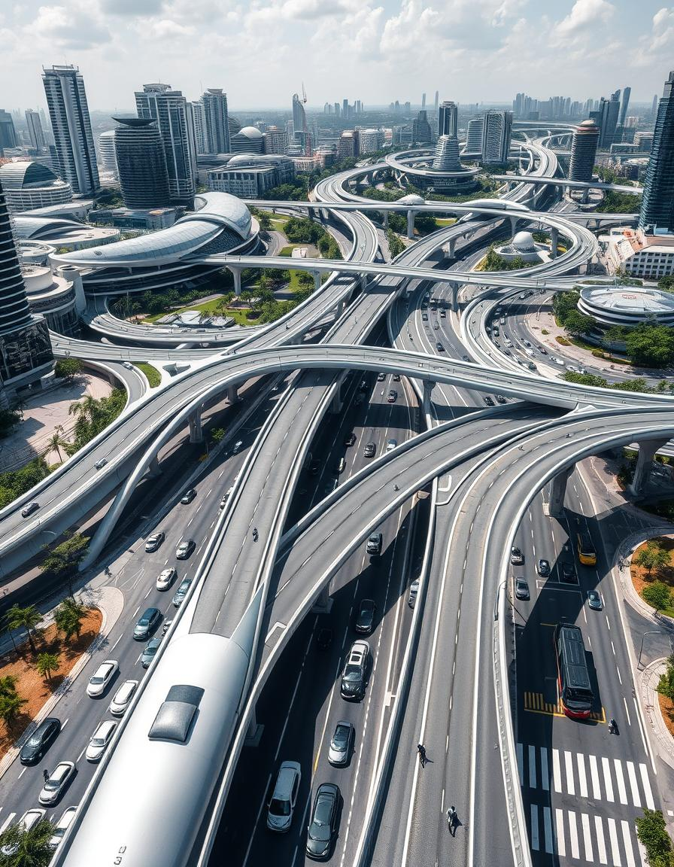
Key Applications
Singapore's smart city Transportaion and urban mobility
Intelligent Transport System(ITS)
Traffic Smart & ONE Motoring Portals provide drivers with real-time traffic information in every 5-minute interval from CCTV & GPS.
Smart Traffic Enforcment
Your speed signs show real-time driver speeds to reduce speeding and improve safety.
ERP ( Electronic Road pricing)
Dynamic toll system that adjust prices based on traffic volume.
SimMobility modeling platform
Simulate real- world transportation behavior across the city using AI.

Slide 7
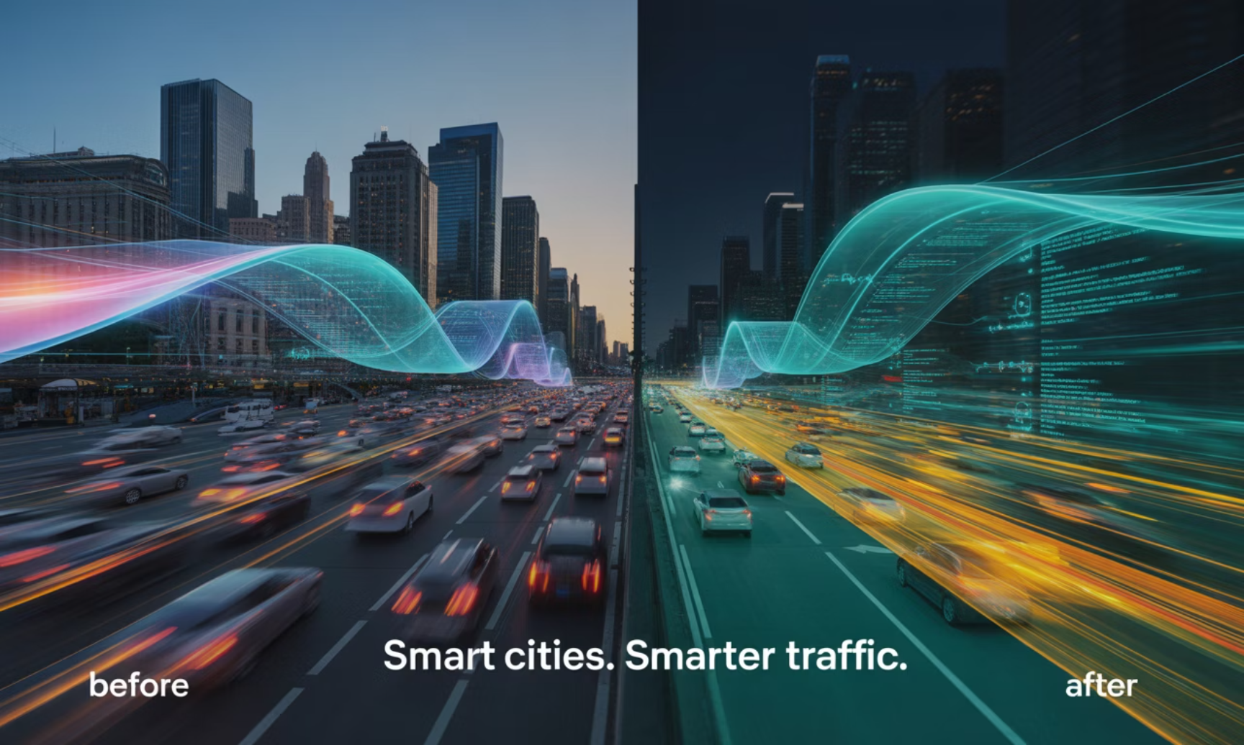
Impact & Benefits
Reduce Congestion: Deep minds system cut traffic wait time up to 30%.
Smarter planning Cities use real time data to plan better public transportation and infrastructure.
Improve Safety smart enforcement (speed sign, accident detection ).
Lower Emission AI –based route optimization reduce fuel usage and air pollution.
Cost saving, efficient traffic flow and smart energy use reduce city spending.

Slide 8
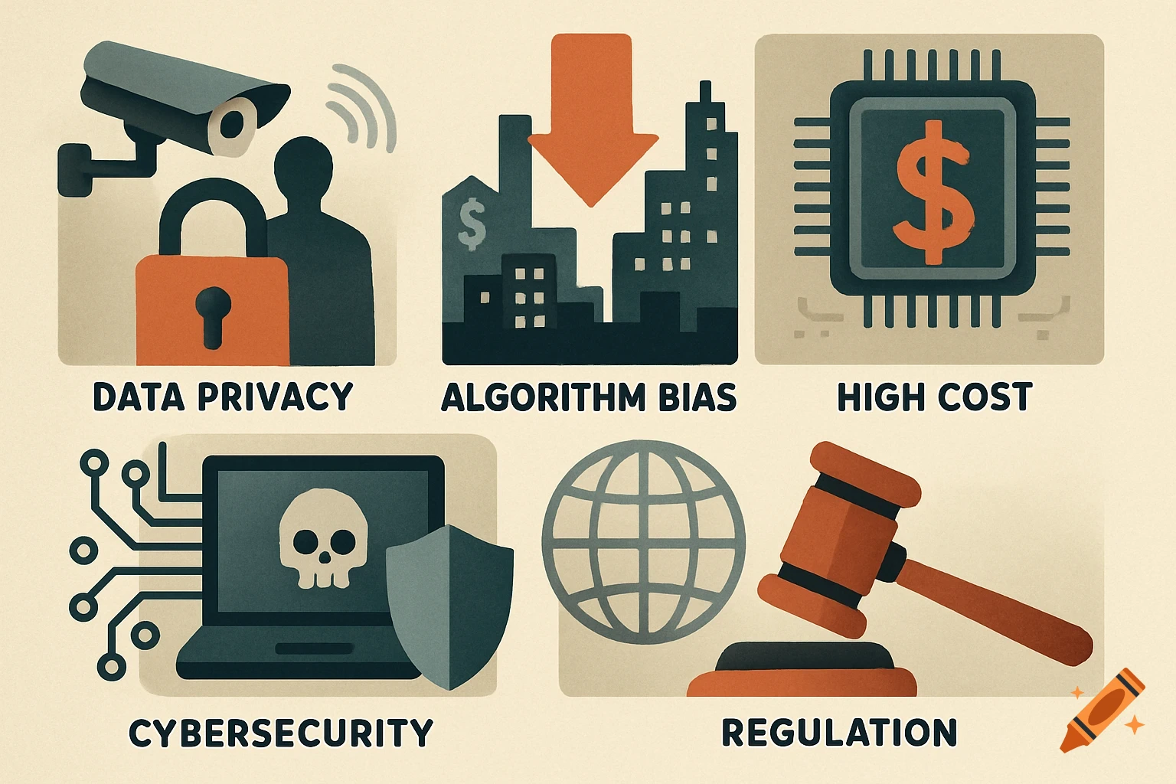
Challenges & Risks
Data privacy , constant monitoring via sensors and CCTV raise surveillance concern.
Algorithm Bias , AI system may favor high- income or higher traffic area , causing unfair services.
High cost, Initial investment in infrastructure , sensors and AI system is expensive.
Cybersecurity , Smart system are vulnerable to hacking and need strong protection.
Regulation, Lack of global standard s for ethical use in public systems.

Slide 9
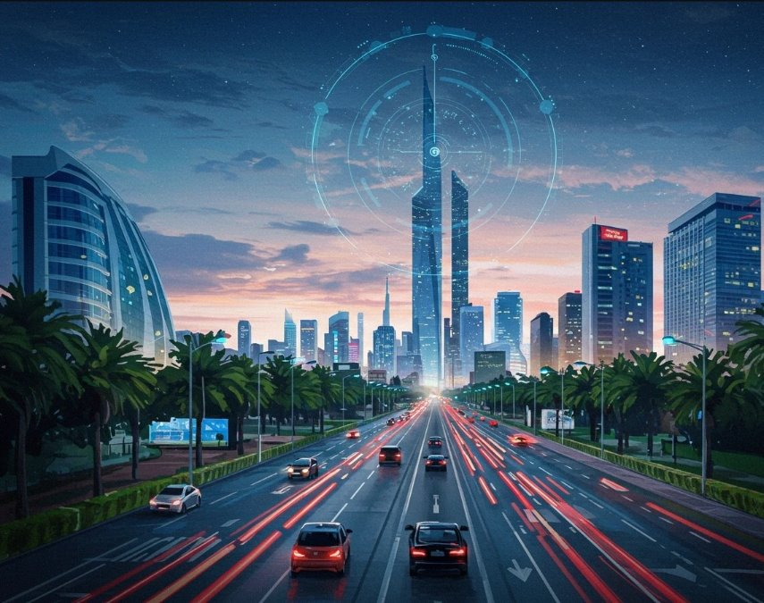
Future Directions
Federated Learning enables AI training across location without sharing sensitive data.
Multimedia AI combine traffic , weather , and real time reports for better prediction.
Autonomous Vehicles, integrated into smart infrastructure for safer navigation.
Sustainable AI Optimize for eco-friendly outcome, (energy – aware routing ).
Global standard push for unified frameworks for AI ethics and urban planning.

Slide 10
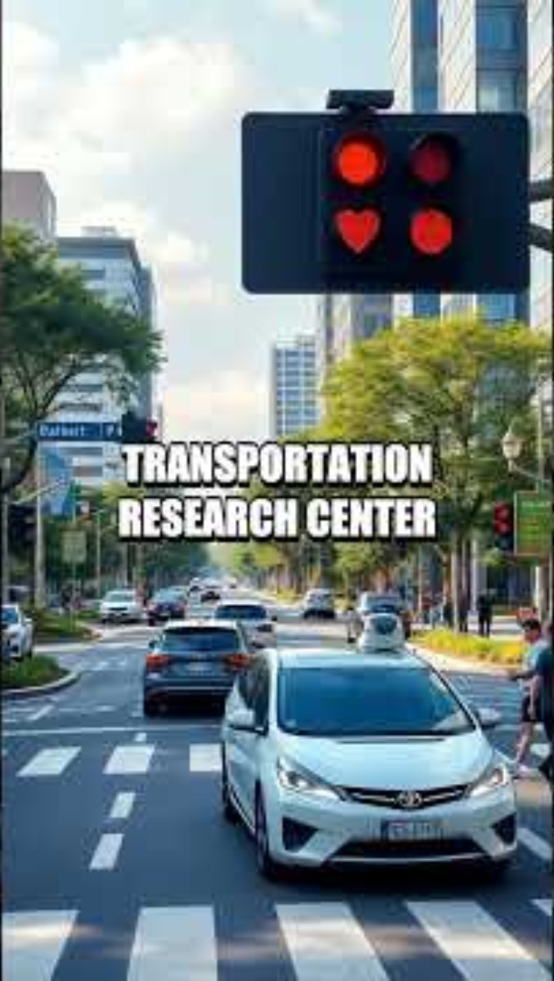
Interactive Slide / Demo

Slide 11
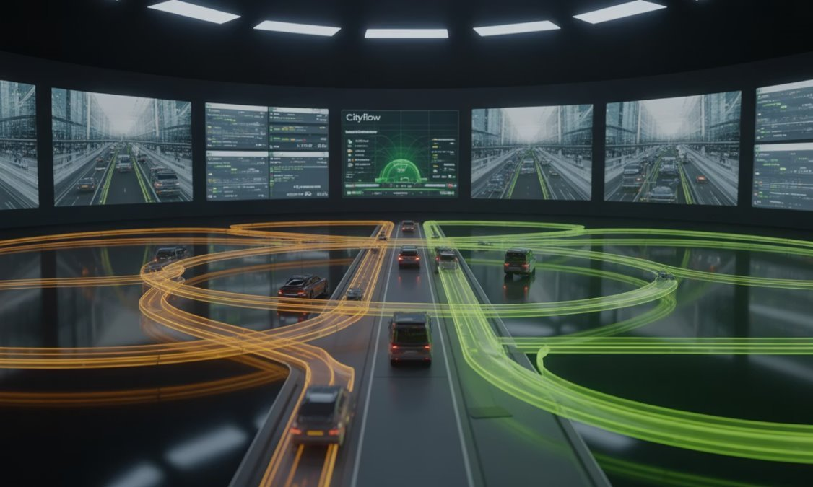
Conclusion
AI transforming Urban life ,especially in transportation.
Smart systems reduce congestion, pollution , and delays.
Real- world example like Singapore, DeepMind , and Tesla prove AI effectiveness.
To succeed, smart cities must balance innovation ,privacy, and sustainability.
A smart city is not just connected – its responsive and responsible.

Slide 12
References & Acknowledgments
DeepMind Smart Traffic. (2022). https://www.deepmind.com/blog/smart-traffic-lights
Siemens Mobility AI. (2021). https://www.mobility.siemens.com/global/en.html
Tesla Autopilot. (2023). https://www.tesla.com/autopilot
Singapore Smart Transport. (2020). https://www.lta.gov.sg
Waze Traffic AI. (2022). https://www.waze.com
International Case Studies of Smart Cities - IADB Publications, publications.iadb.org/publications/english/document/International-Case-Studies-of-Smart-Cities-Singapore-Republic-of-Singapore.pdf. Accessed 23 June 2025.

